Slide 1
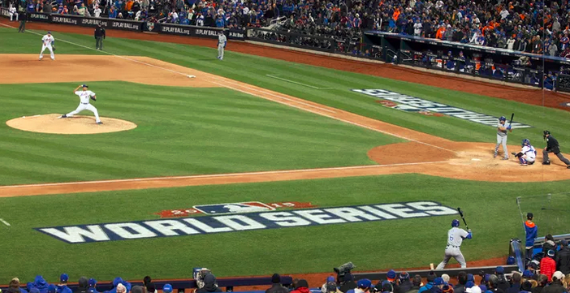
Does Home-Field Advantage matter in World Series?
by Team: Lanqin Zhao, Yan Wang, Jie Hu

Slide 2
about Home-Field Advantage
Home-field advantage is having an advantage in a sporting event where the home team benefits from playing at home.
HFAdv = HW% - AW%
HFAdv : Home-field Advantage
HW% : Home Winning Percentage
AW% : Away Winning Percentage

Slide 3
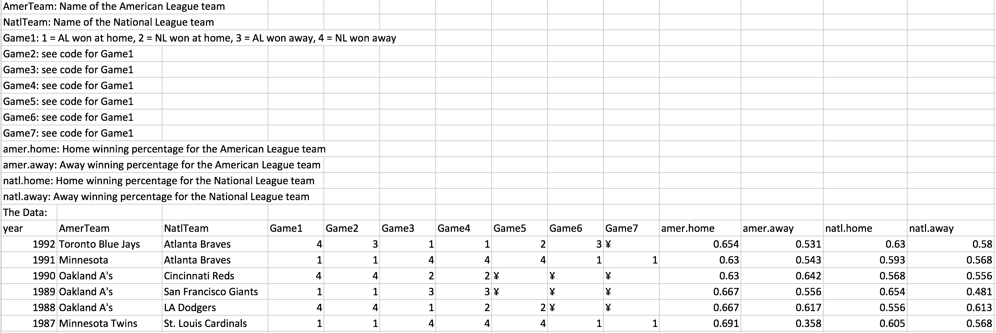
HFAdv in Baseball
Exists?
2 – NL won away
4 – NL won at home
World Series
Seasons

Slide 4
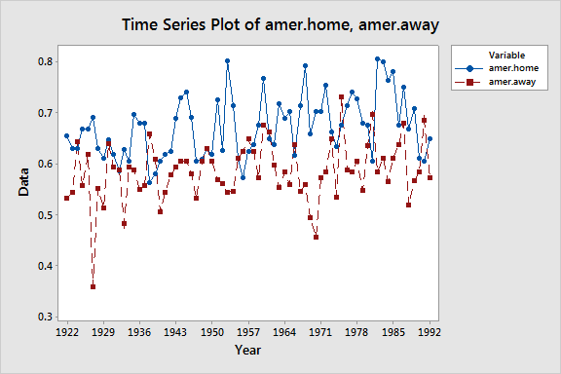
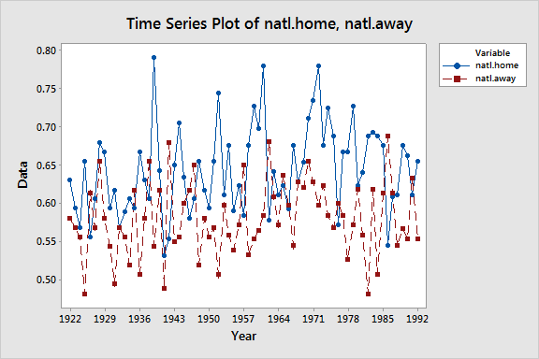
HFAdv in Baseball
Exists?
AL
NL
Seasons

Slide 5
HFAdv in Baseball
H0: HFAdv doesn’t exist, µ_{HFAdv} (or HW% - AW%) <= 0
HA: HFAdv exists, µ_{HFAdv} (or HW% - AW%) > 0
Test result:
z(AL) = 8.39 p-value < 0.001
z(NL) = 6.45 p-value < 0.001
Conclusion: Reject H0
There’s significant evidence that
HFAdv exists in both Champion Series

Slide 6
HFAdv in Baseball
95% Confidence Interval of HFAdv:
NL: (0.04, 0.08)
0.04
0.06
0.08
0.10
AL: (0.06, 0.11)
We can assume both leagues have the same HFAdv!

Slide 7
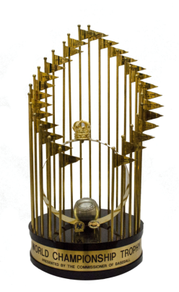
Does Home-Field Advantage matter
in World Series?
Prior to 2003, home-field advantage in the World Series alternated from year to year between the NL and AL.
Since 2003, the team winning the all-star game is awarded home field advantage.
Home field advantage
?

Slide 8
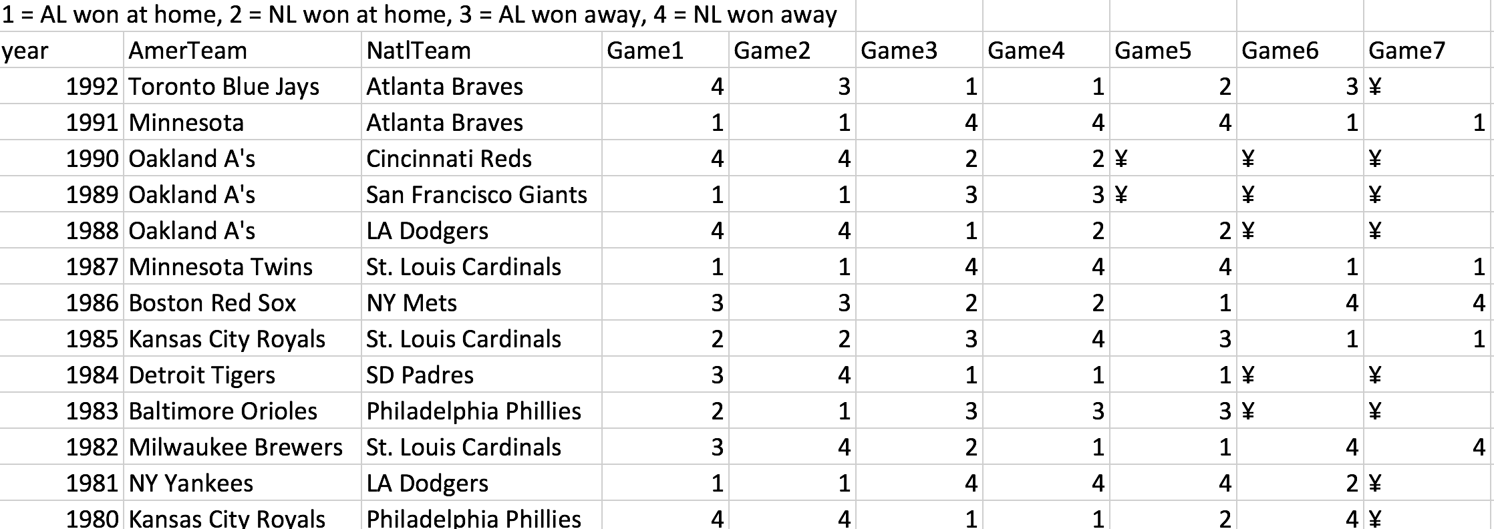
Does Home-Field Advantage matter
in World Series?
1 = AL won at home, 2 = NL won away, 3 = AL won away, 4 = NL won at home

Slide 9
- World Series – test for 7-games
H₀: Winning the World Series and having home field advantage are independent
H_{a}: Winning the World Series and having home field advantage are dependent
 | AL had HFA | NL had HFA | Total
AL Win Counts | 7 | 6 | 13
Expected Counts | 6.933 | 6.067 | 13
NL Win Counts | 9 | 8 | 17
Expected Counts | 9.067 | 7.933 | 17
Total | 16 | 14 | 30
Test result:
Pearson Chi-Square = 0.002, DF = 1, P-Value = 0.961
Likelihood Ratio Chi-Square = 0.002, DF = 1, P-Value = 0.961
Conclusion: Failed to reject H0
There’s no significant evidence that Winning the World Series and having home field advantage are dependent.

Slide 10
Generally:
Home-field advantage does exist in season games,
BUT There’s no sufficient evidence that
Home-field advantage is important for a team to win Commissioner’s Trophy

Slide 11


Discussion
Why even having home field advantage doesn’t matter in winning the World Series, they still built up All-Star series to determine which league has right of home field advantage?

Slide 12
Thank you!

